Slide 1
Understanding the centre of rotation
Transformations

Slide 2
how to use Oak lessons

Slide 3
I can understand the minimum information required to fully describe a rotation.

Slide 4
The centre of rotation is the fixed point about which an object is rotated.

Slide 5

Understanding the centre of rotation
Describing with the centre of rotation
Finding the centre of rotation for 180° rotations

Slide 6
Describing with the centre of rotation
Even if an object is rotated by the same amount, and in the same direction, it is possible for the image to end up in a different location.

Slide 7
Describing with the centre of rotation
Even if an object is rotated by the same amount, and in the same direction, it is possible for the image to end up in a different location.

Slide 8
Describing with the centre of rotation
What defines the location of the image is the centre of rotation.
The centre of rotation acts as a fixed point, or pivot, for the rest of the shape as it rotates.

Slide 9

Describing with the centre of rotation
The centre of rotation can be anywhere:
on a vertex of the object
outside the object
inside the object

Slide 10
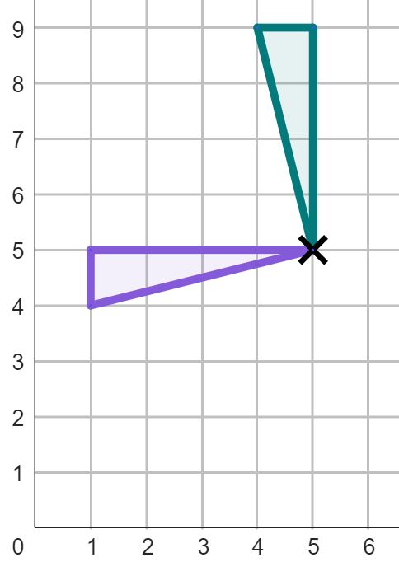
Describing with the centre of rotation
The centre of rotation can be on the vertex of the object.
We can describe the location of the centre of rotation as a coordinate.
The centre of rotation is at (5, 5).

Slide 11
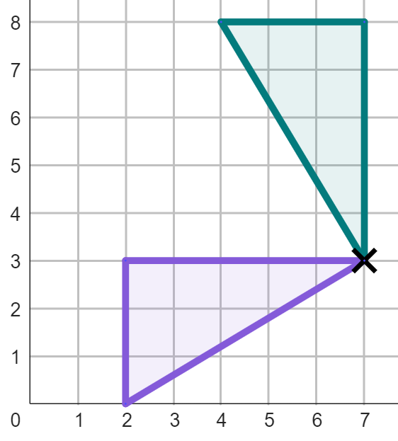
Describing with the centre of rotation
Four pieces of information are needed to fully describe a rotation:
Stating that it is a rotation, the direction, size and centre of rotation
Rotation, anti-clockwise, by 90°, centre of rotation at (7, 3)
Which can be turned into a full sentence:
“The object has been rotated anti-clockwise through 90° about (7,3).”

Slide 12
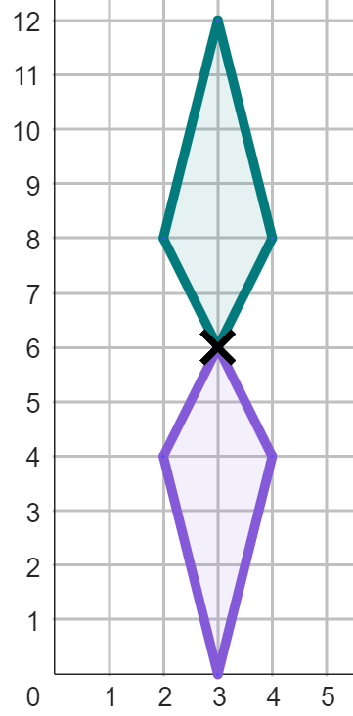


Describing with the centre of rotation
Which of these is the correct coordinate for the centre of rotation of this object?
a
(6, 3)
b
(3, 6)
c
(3, 0)
d
(3, 8)

Slide 13
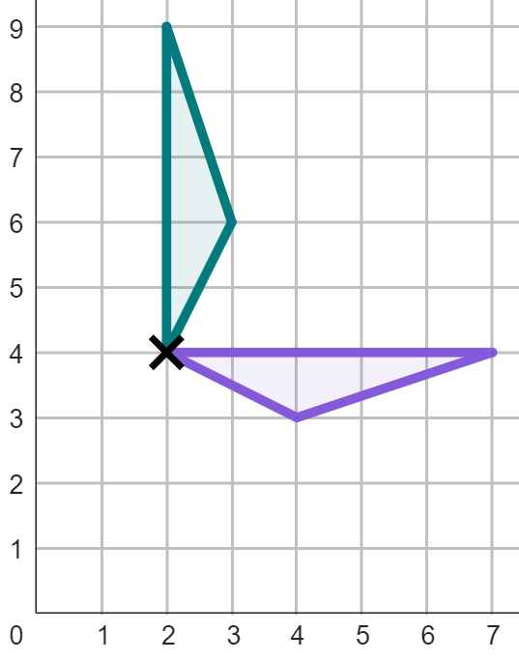
Describing with the centre of rotation
Complete the description for this rotation.
This rotation is:
clockwise
by 90°
with a centre of rotation of
.
(2, 4)

Slide 14
Describing with the centre of rotation
If a vertex of an object is the centre of rotation, then the location of that vertex is invariant.
Because the centre of rotation acts as a pivot or fixed point for the rest of the shape.
Because all the vertices of an object move location when it has been rotated.

Slide 15
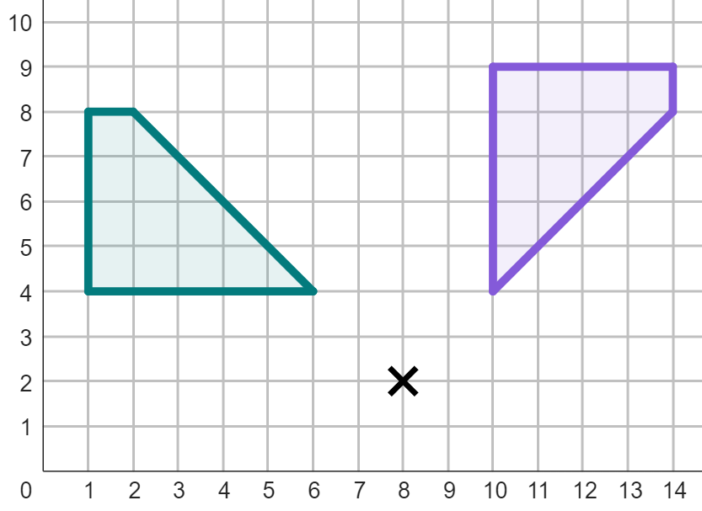
Describing with the centre of rotation
The centre of rotation can be outside the object.
The centre of rotation still acts as a pivot, but imagine it now being attached to the object by an imaginary rope that rotates with the object.

Slide 16
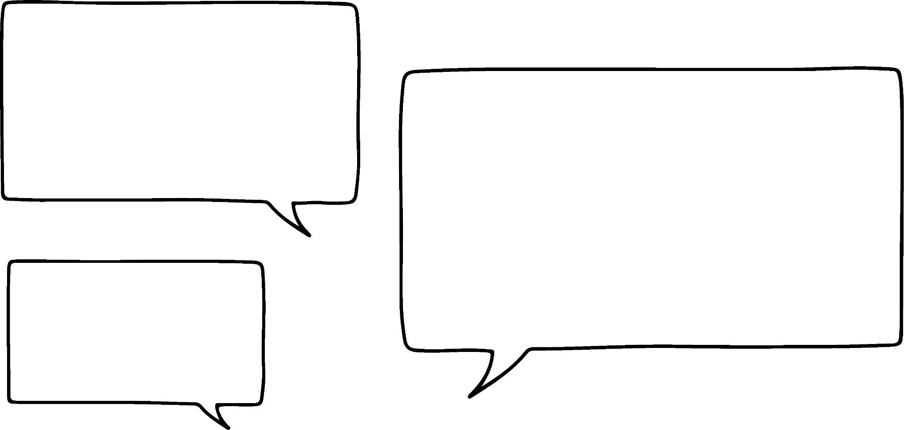
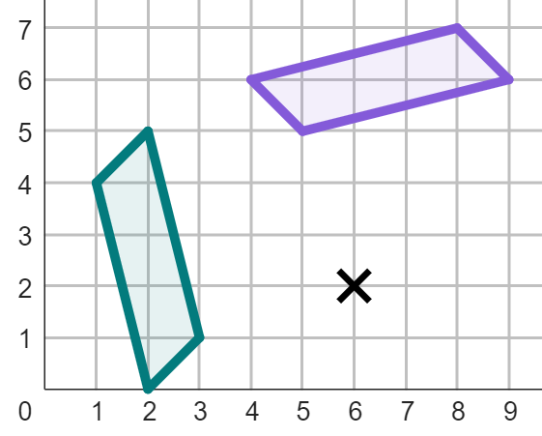
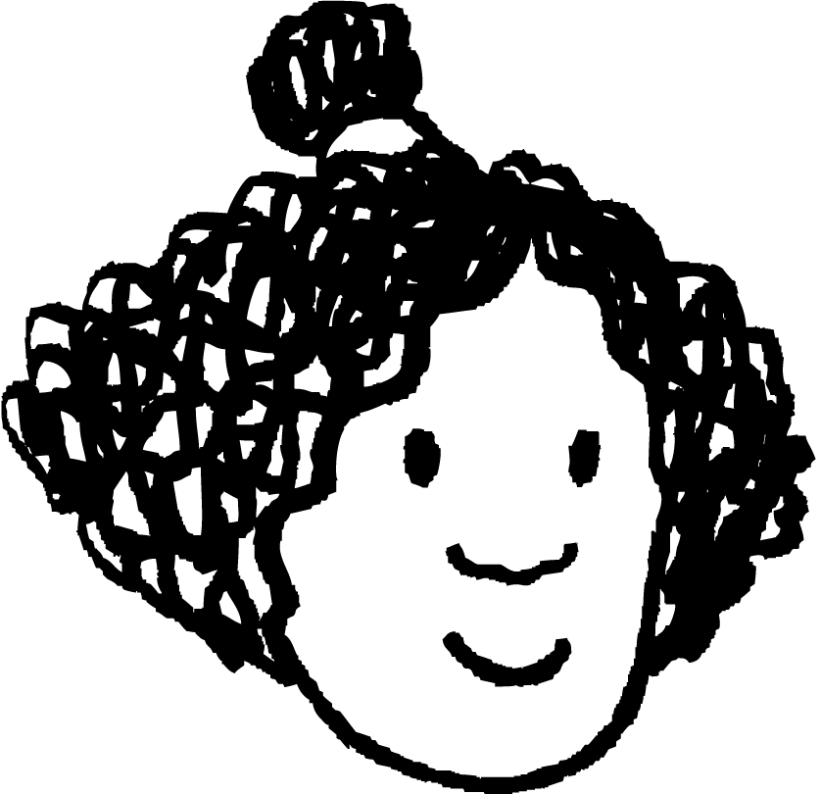
Describing with the centre of rotation
Complete Izzy’s description of the rotation.
The object has been rotated 90° in the . direction, with a centre of rotation of .
clockwise
(6, 2)

Slide 17
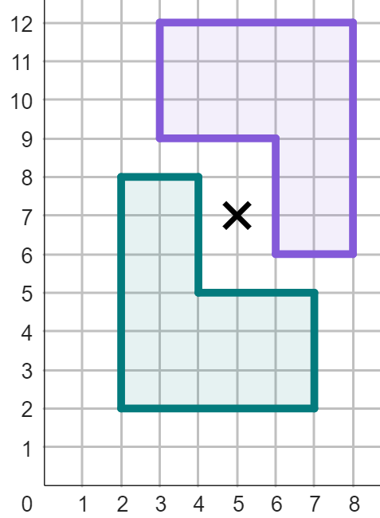
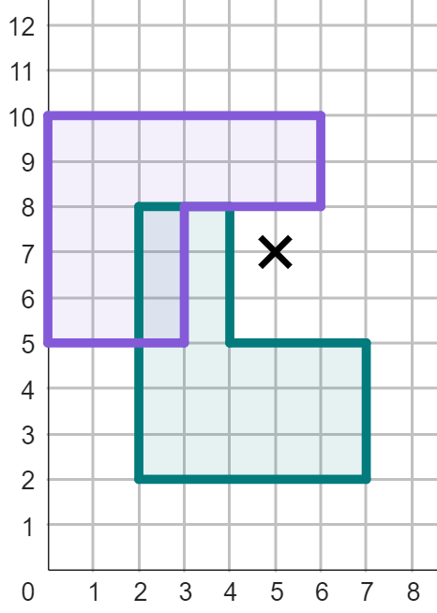
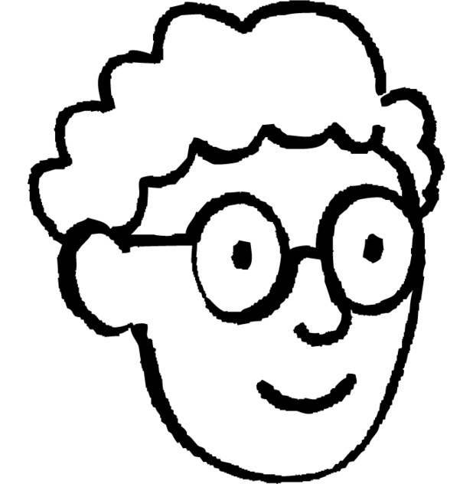
Describing with the centre of rotation
If the centre of rotation is outside the object, then the object and image will not overlap when the object is rotated.
Alex
Whilst this object does not overlap with its image when rotated by 180°,
it does when rotated by 90° clockwise.
Alex is wrong. Images might overlap the object, no matter where the centre of rotation is.

Slide 18
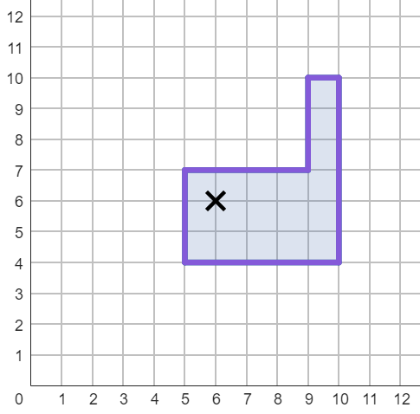
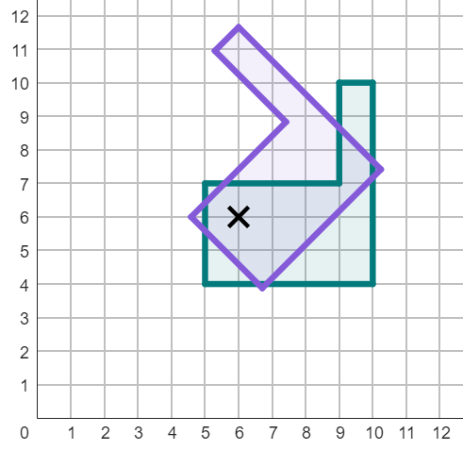
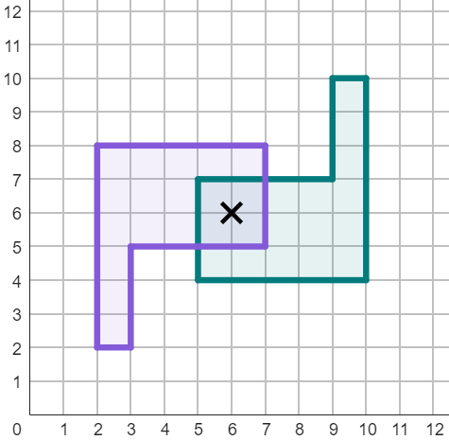
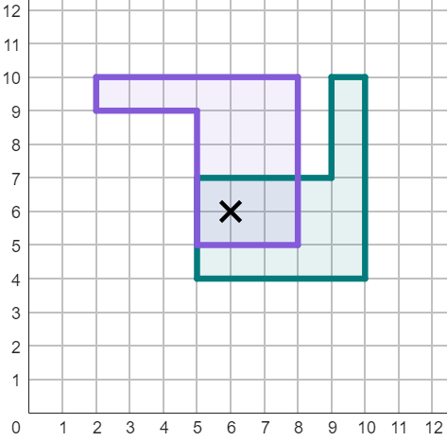
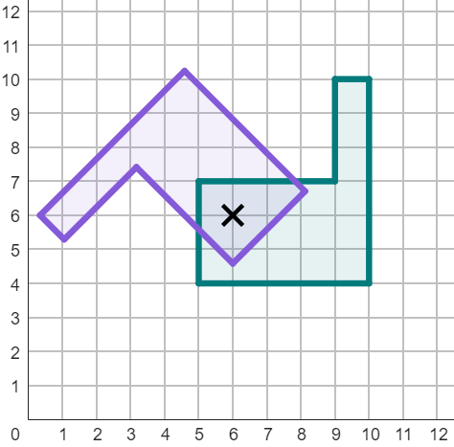
Describing with the centre of rotation
The centre of rotation can be inside the object.
The object and image will always overlap at least slightly when the centre of rotation is inside the object.

Slide 19
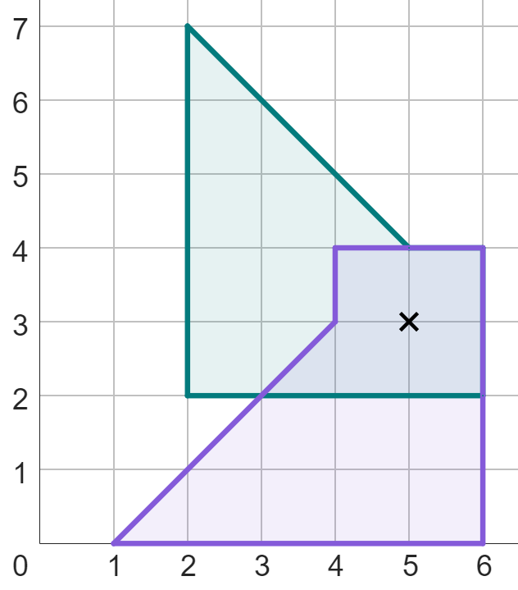

Describing with the centre of rotation
Complete Laura’s description of the rotation.
object
The object has been rotated 90° in the . direction, with a centre of rotation of .
anti-clockwise
(5, 3)
image

Slide 20
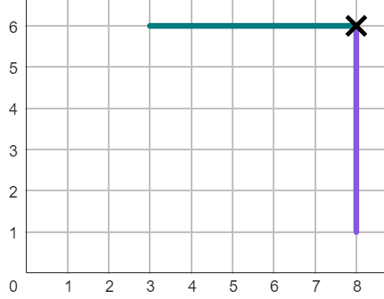
Describing with the centre of rotation
1) The line has been rotated less than 360°.
Complete the information for the rotation of this line:
The object has been rotated:
anti-clockwise
by °
with a centre of rotation at .

Slide 21
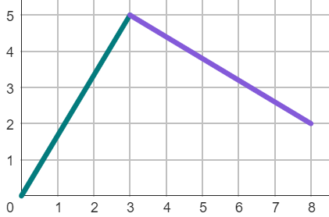
Describing with the centre of rotation
2) The line has been rotated less than 360°.
Complete the information for the rotation of this line:
The object has been rotated:
clockwise
by °
with a centre of rotation at .

Slide 22
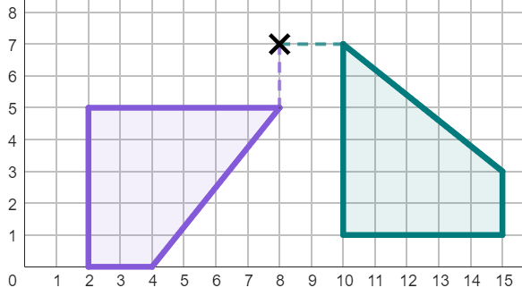
Describing with the centre of rotation
3) The object has been rotated less than 360°.
Complete the information for the rotation:
The object has been rotated:
clockwise
by °
with a centre of rotation at .

Slide 23
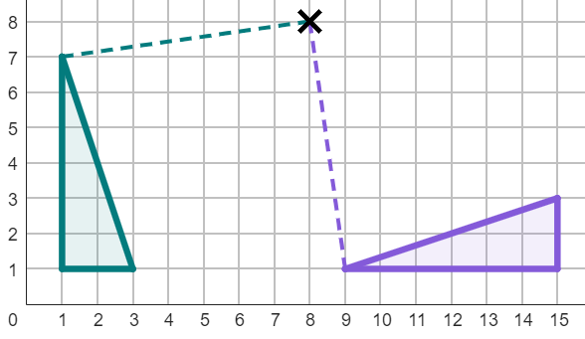
Describing with the centre of rotation
4) The object has been rotated less than 360°.
Complete the information for the rotation:
The object has been rotated:
anti-clockwise
by °
with a centre of rotation at .

Slide 24
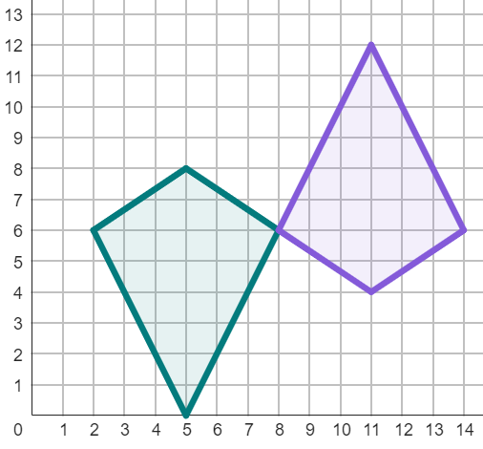
Describing with the centre of rotation
5) There are lots of ways to fully describe this rotation. Complete these two descriptions:
The object has been rotated:
clockwise
by °
with a centre of rotation at .
The object has been rotated:
anti-clockwise
by °
with a centre of rotation at .

Slide 25
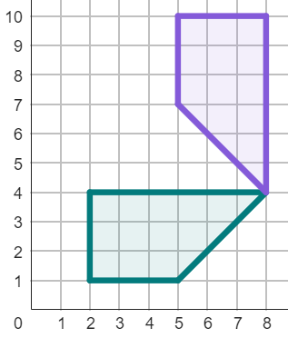
Describing with the centre of rotation
6) There are two ways of describing this rotation, if done in less than a full turn. Complete both descriptions:
image
The object has been rotated:
clockwise
by °
with a centre of rotation at .
The object has been rotated:
.
.
.
object

Slide 26
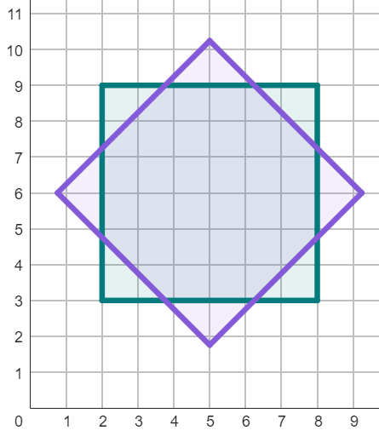
Describing with the centre of rotation
7) There are multiple possible descriptions that could correctly describe this rotation. Fully describe this rotation in one way.
image
The object has been rotated:
.
by °
with a centre of rotation at .
object

Slide 27
Describing with the centre of rotation
1) The line has been rotated less than 360°.
Complete the information for the rotation of this line:
The object has been rotated:
anti-clockwise
by °
with a centre of rotation at
90
(8, 6)

Slide 28
Describing with the centre of rotation
2) The line has been rotated less than 360°.
Complete the information for the rotation of this line:
The object has been rotated:
clockwise
by °
with a centre of rotation at
270
(3, 5)

Slide 29
Describing with the centre of rotation
3) The object has been rotated less than 360°.
Complete the information for the rotation:
The object has been rotated:
clockwise
by °
with a centre of rotation at
90
(8, 7)

Slide 30
Describing with the centre of rotation
4) The object has been rotated less than 360°.
Complete the information for the rotation:
The object has been rotated:
anti-clockwise
by °
with a centre of rotation at
90
(8, 8)

Slide 31
Describing with the centre of rotation
5) There are lots of ways to fully describe this rotation. Complete these two descriptions:
The object has been rotated:
clockwise
by °
with a centre of rotation at .
180
Or (180 + 360n)°
(8, 6)
The object has been rotated:
anti-clockwise
by °
with a centre of rotation at .
180
Or (180 + 360n)°
(8, 6)

Slide 32
Describing with the centre of rotation
6) There are two ways of describing this rotation, if done in less than a full turn. Complete both descriptions:
image
The object has been rotated:
clockwise
by °
with a centre of rotation at .
90
(8, 4)
The object has been rotated:
Anti-clockwise 270°
with a centre of rotation at (8, 4)
object

Slide 33
Describing with the centre of rotation
7) There are multiple possible descriptions that could correctly describe this rotation. Fully describe this rotation in one way.
image
The object has been rotated:
anti-clockwise
.
by °
with a centre of rotation at .
45
(5, 6)
Can either be clockwise or anti-clockwise
Angle must be 45° greater than a multiple of 90°, such as 135° or 215°.
Centre of Rotation must be (5, 6).
object

Slide 34
Understanding the centre of rotation
Describing with the centre of rotation
Finding the centre of rotation for 180° rotations

Slide 35
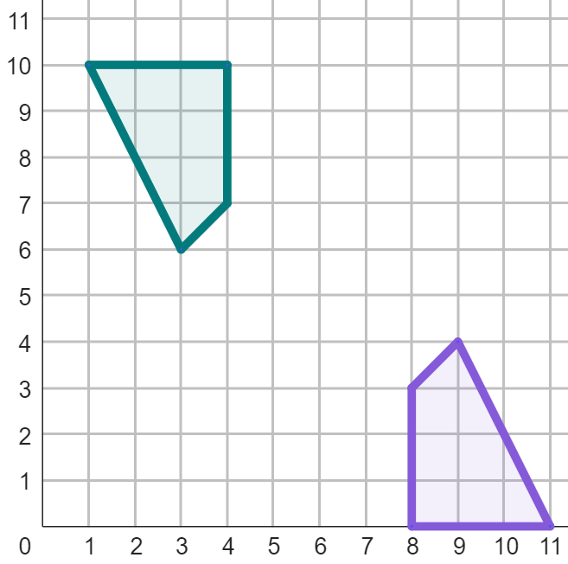
Finding the centre of rotation for 180° rotations
For 180° rotations, you can find the centre of rotation by:
connecting together corresponding points on the object and image with line segments
finding where the line segments intersect
The centre of rotation is (6, 5).

Slide 36
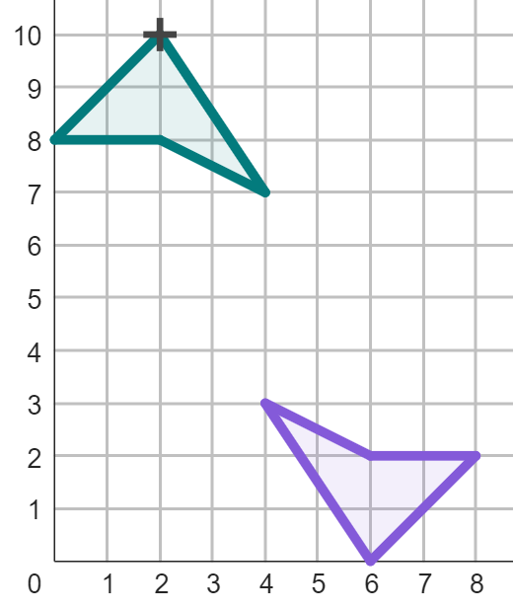
Finding the centre of rotation for 180° rotations
A
The point A is corresponding with which point on its image?
H
E
F
G
H

Slide 37
Finding the centre of rotation for 180° rotations
A
The point A has been connected to its corresponding point on the image.
Find the centre of rotation.
The centre of rotation is (4, 5).

Slide 38
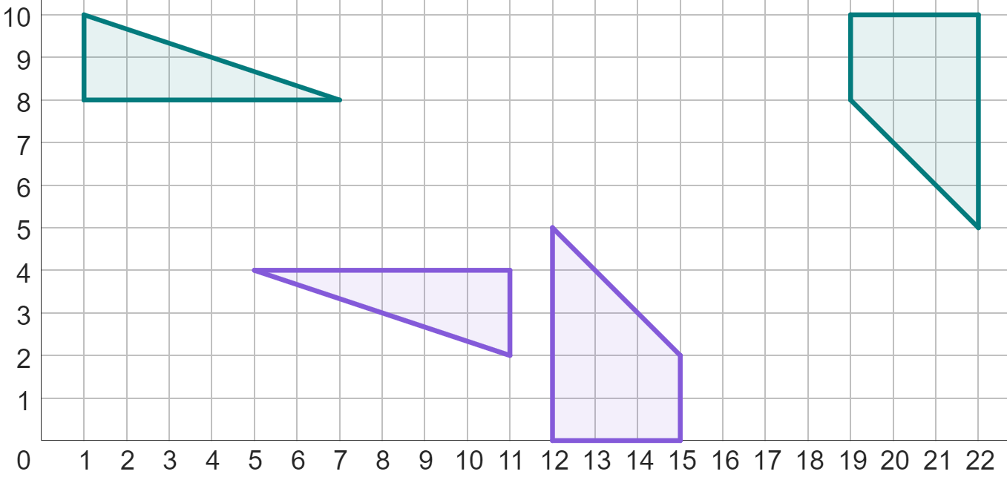
Finding the centre of rotation for 180° rotations
1) Below are two rotations where an object and its image have two pairs of corresponding vertices labelled. By connecting these corresponding vertices with line segments, find the centre of rotation of each object.
B
A
C
D′
A′
D
B′
C′

Slide 39
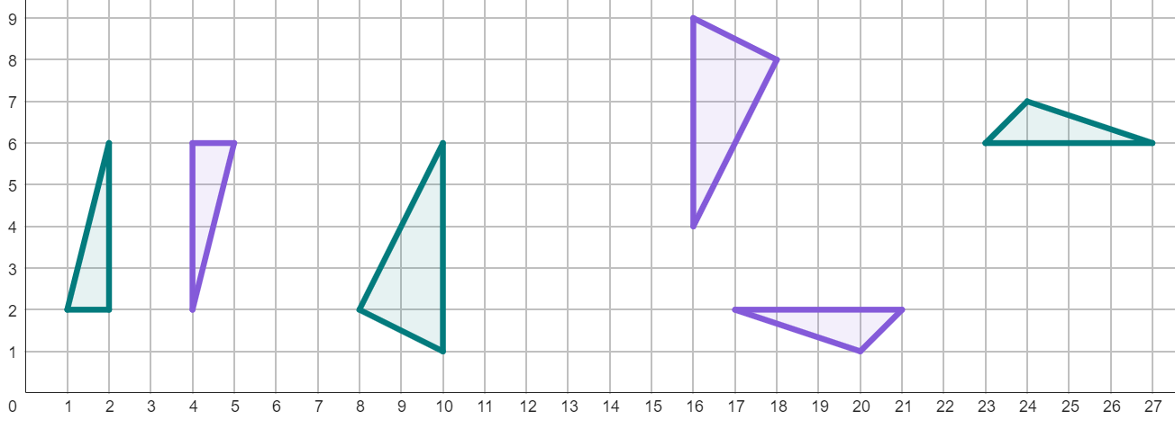
Finding the centre of rotation for 180° rotations
2) By connecting corresponding points on the object and image, find the centre of rotation for these rotations.
3) Complete the sentence below:
“To find the centre of rotation by connecting corresponding points, the image must have been rotated by °.”

Slide 40
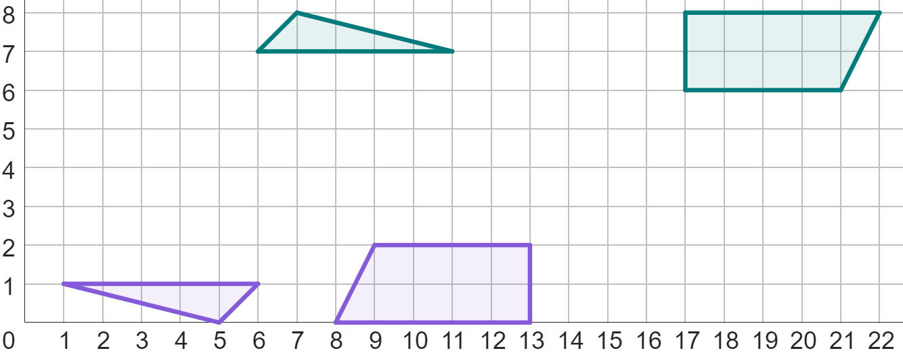
Finding the centre of rotation for 180° rotations
4) Fully describe these rotations.
object 1
object 2

Slide 41
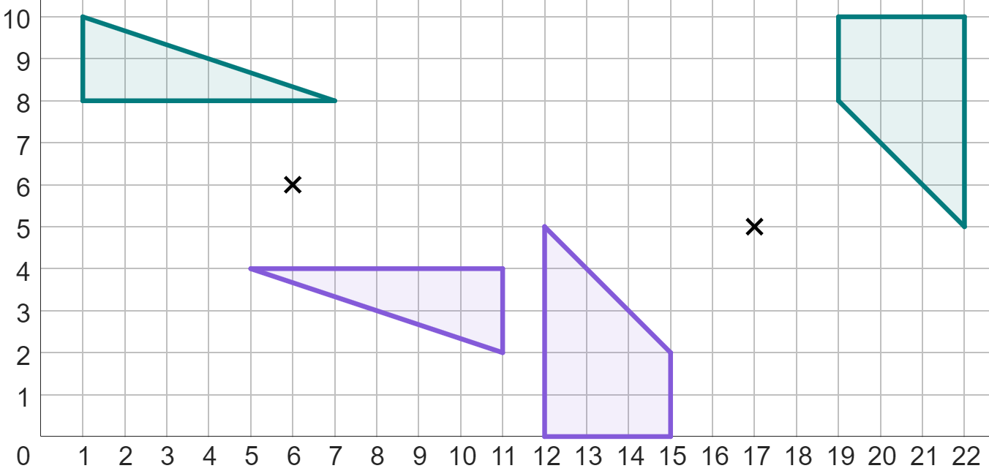
Finding the centre of rotation for 180° rotations
1) Below are two rotations where an object and its image have two pairs of corresponding vertices labelled. By connecting these corresponding vertices with line segments, find the centre of rotation of each object.
B
A
C
(6, 6)
D′
A′
D
(17, 5)
B′
C′

Slide 42
Finding the centre of rotation for 180° rotations
2) By connecting corresponding points on the object and image, find the centre of rotation for these rotations.
(3, 4)
(13, 5)
(22, 4)
3) Complete the sentence below:
“To find the centre of rotation by connecting corresponding points, the image must have been rotated by °.”
180

Slide 43
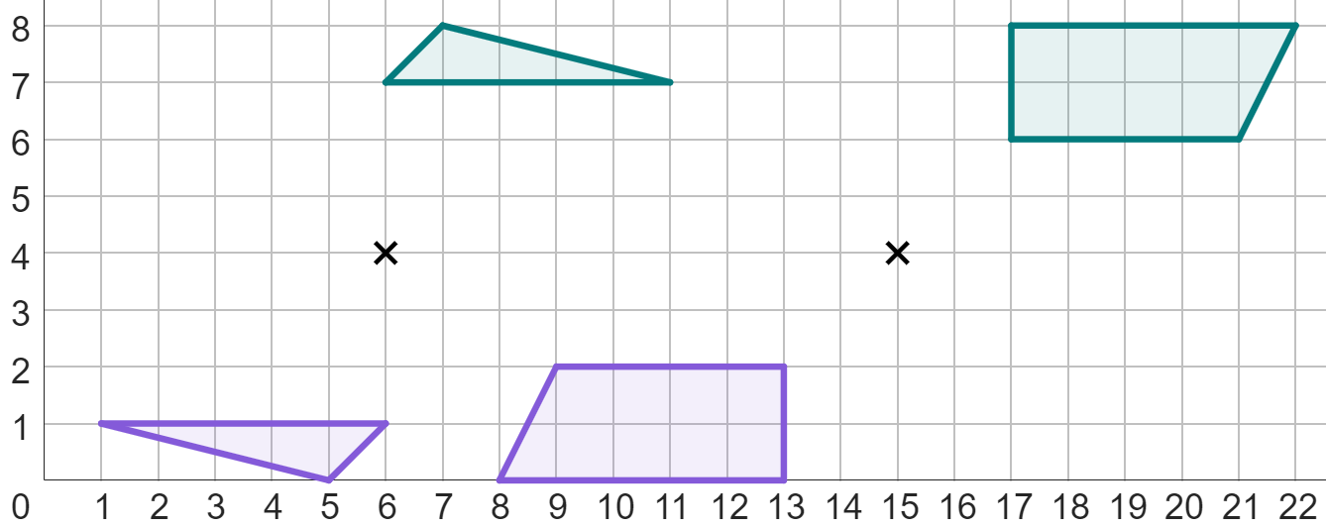
Finding the centre of rotation for 180° rotations
4) Fully describe these rotations.
object 1
object 1
object 2
object 2
Object 1 has been rotated 180° around the centre of rotation of (6, 4).
Object 2 has been rotated 180° around the centre of rotation of (15, 4).

Slide 44
Understanding the centre of rotation
The centre of rotation is essential in defining the location of an image after rotation.
Formally defining a rotation comes in three parts: the direction, the size (in degrees), and the centre of rotation.
The centre of rotation can be found for all 180° rotations by connecting corresponding points on the object and image with a line segment, and finding the point of intersection.

Slide 45

© Oak National Academy 2023.
Produced in partnership with Mathematics in Education and Industry.
Licensed on the Open Government Licence v3.0, except where otherwise stated. See Oak terms and conditions.

